Slide 1


Slide 2
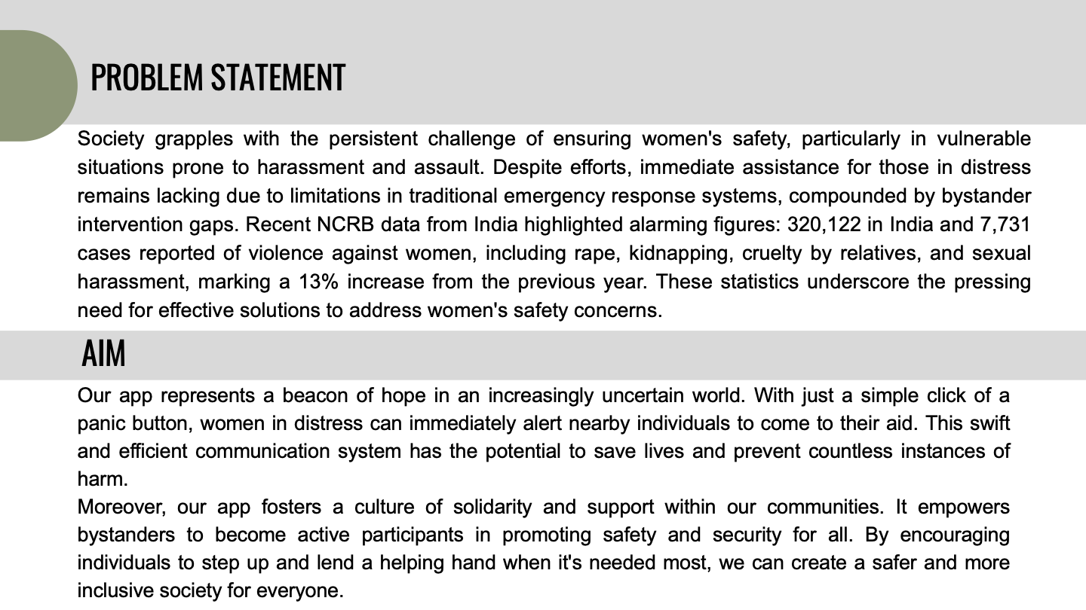
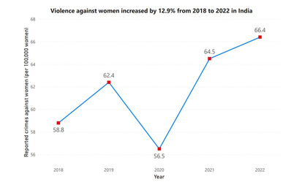

Slide 3








SOLUTION & ITS IMPACT
Team
Shield
Bystander’s Intervention
This feature surrounds women with a network of nearby bystanders ready to help, creating a profound sense of security. It ensures they are never alone, boosting their confidence and allowing them to move through the world with greater peace and freedom.
Enhanced Personal Safety
Provides real-time alerts about potential threats and information on the safety levels of various areas, helping users avoid risks and stay secure.
Improved Emergency Response
Facilitates swift communication with emergency contacts or services and allows users to report incidents quickly, leading to faster assistance.
Impact of Area Profiling
Area profiling identifies high-risk zones and provides real-time safety insights, Especially crucial when moving to new places. Gender-segregated data further helps women make informed decisions and navigate confidently and securely.
Solution
&
Impact
Stronger Community Support
Encourages users to collaborate, share information, and support one another, fostering a connected and engaged community
Influence of Community Feed
Our community feed amplifies voices and support, allowing users to share photos and details of wrongdoers, and fostering accountability. With awareness campaigns and NGO partnerships, it enhances safety and drives positive social change.
Increased Confidence
Empowers users with tools and resources for personal safety, providing reassurance and boosting confidence in managing their security.
HerShield: Help is just a moment away !!
5

Slide 4


Team
Shield
Work Flow Diagram
HER SHIELD
NOTIFY BYSTANDERS
NOTIFY EMERGENCY SERVICES
REAL-TIME TRACKING
Voice Gesture
LOGIN/SIGNUP
SOS
(Panic Screen)
AREA SECURITY INDEX
GENDER DISTRIBUTION
LONE WOMAN DETECTION
PROTECTORS AVAILABLITY
Personality Test
Area Profiling
(Scan your proximity)
Profile approved?
NGO SUPPORT
REPORT LATEST INCIDENTS
AWARENESS CAMPAIGNS
VIRTUAL PROTESTS
Community Feed
(Security Awareness)
No
Yes
Arya - AI assistant
(Your trusted Listener)
NON-JUDGEMENTAL SUPPORT
PERSONALISED ADVICE
SAFETY TIPS AND GUIDANCE
BASIC FEATURES ACCESS
User Profile
(User Info)
AWARDED BADGE OF HONOUR
PROTECTOR MODE - ON/OFF
PERSONAL DETAILS
EMERGENCY CONTACTS
SOS (Panic Screen)

Slide 5



Team
Shield
FEASIBILITY AND VIABILITY
Potential Challenges
Handling Strategies
TECHNOLOGY STACK
ASSESS THE COMPATIBILITY OF FLUTTER, FIREBASE, TENSORFLOW, AND OTHER TECHNOLOGIES.
INTEGRATION
EVALUATE HOW WELL THE DIFFERENT COMPONENTS (MAPS, REAL-TIME TRACKING, AI) WORK TOGETHER.
SCALABILITY
THERE ARE TWO TECHNIQUES TO OVERCOME THE GROWING DATABASE ISSUES WE USE A DUAL DATABASE STRATEGY:
INTEGRATION & PERFORMANCE
OPTIMIZATION STRATEGY
Compatibility issues, and latency can impact app responsiveness and scalability.
Use adaptive coding, performance tuning, and dual database load balancing to enhance scalability.
DATA SECURITY & CONFIDENTIALITY
DATA ENCRYPTION
Technical & Market Feasibility
Sensitive data during SOS events is vulnerable, risking exposure and compromising user trust and privacy.
Implement end-to-end encryption and strict access controls to protect user data and ensure confidentiality.
Target Audience
Identify and analyze the demographics and specific needs of potential users, including safety-conscious individuals and those seeking emotional support.
Demand Analysis
Conduct market research to gauge interest in safety and emotional support apps. Examine trends, user behavior, and the size of the potential user base.
Monetization Strategy
Evaluate potential revenue models, such as premium features, subscriptions, or partnerships, to ensure financial viability and sustainability.
ADOPTION
BARRIERS
COUNTER
MEASURES
Users may be reluctant to adopt new technology without proper education on its features, privacy, and emergency functions.
Provide engaging onboarding form
and transparent communication to build trust and encourage regular use.
4

Slide 6
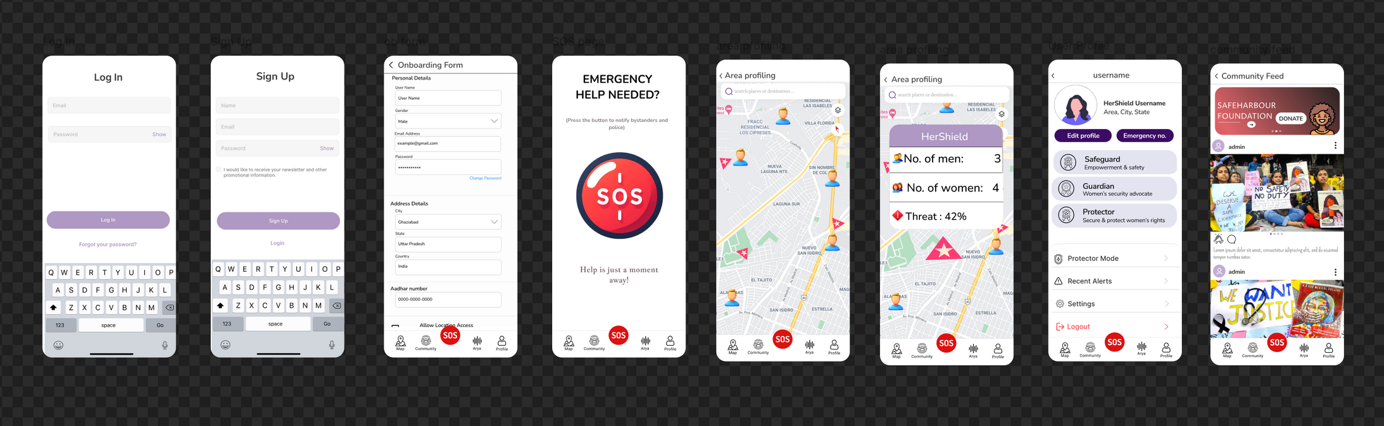
PROPOSED APPLICATION DESIGN

Slide 7

Team
Shield
TECHNICAL APPROACH
Technologies to Be Used : -
Frontend:
Flutter (Dart): Cross-platform
Google Maps API: Map integration
iOS & Wearables: iOS, Wear OS
Backend:
Firebase: Firestore, Firebase Cloud Messaging, Firebase Storage.
Mongo DB: Java Springboot & Nodejs
Geolocator Plugin: Real-time tracking
AI Features:
Python: AI logic & TensorFlow
& Hugging Face: Arya AI Assistant
Personality Test: AI-powered responses assessment.
SOS & Investigation:
Real-time Data Capture: Audio, images, real-time location sharing
Notifications: Firebase Cloud Messaging (FCM):
Methodology and Process :-
Analysis:
Features exploration, User Stories, Competitive Research, Technical Feasibility.
Design:
Architecture: Client-Server, Firebase,
Community Design With Springboot
Database: Firestore, Mongo Db
AI: TensorFlow, Hugging Face
Development:
Sprint 1: Setup, authentication
Sprint 2: SOS feature, APIs
Sprint 3: AI Assistant integration
Sprint 4: Area Profiling, feed
Testing & Deployment:
Testing: Unit, integration, UAT
System Test
3

Slide 8
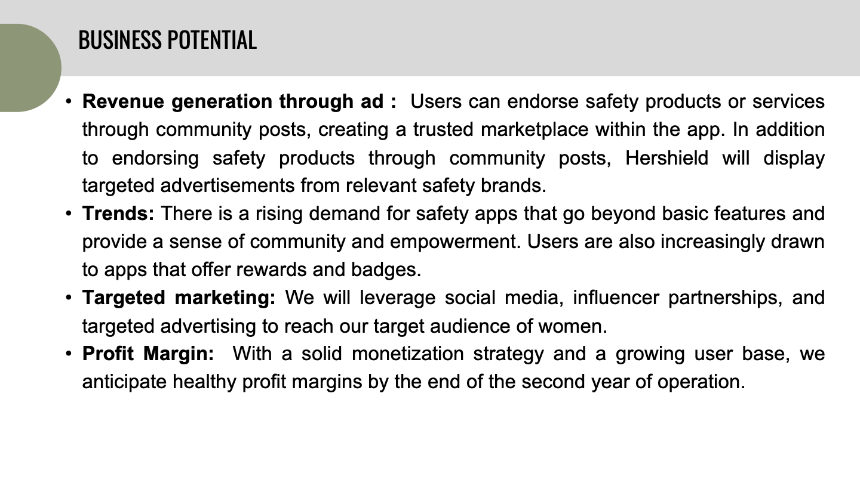

Slide 9
Team Shield
Thank You
Questions are welcomed !!

